Slide 1
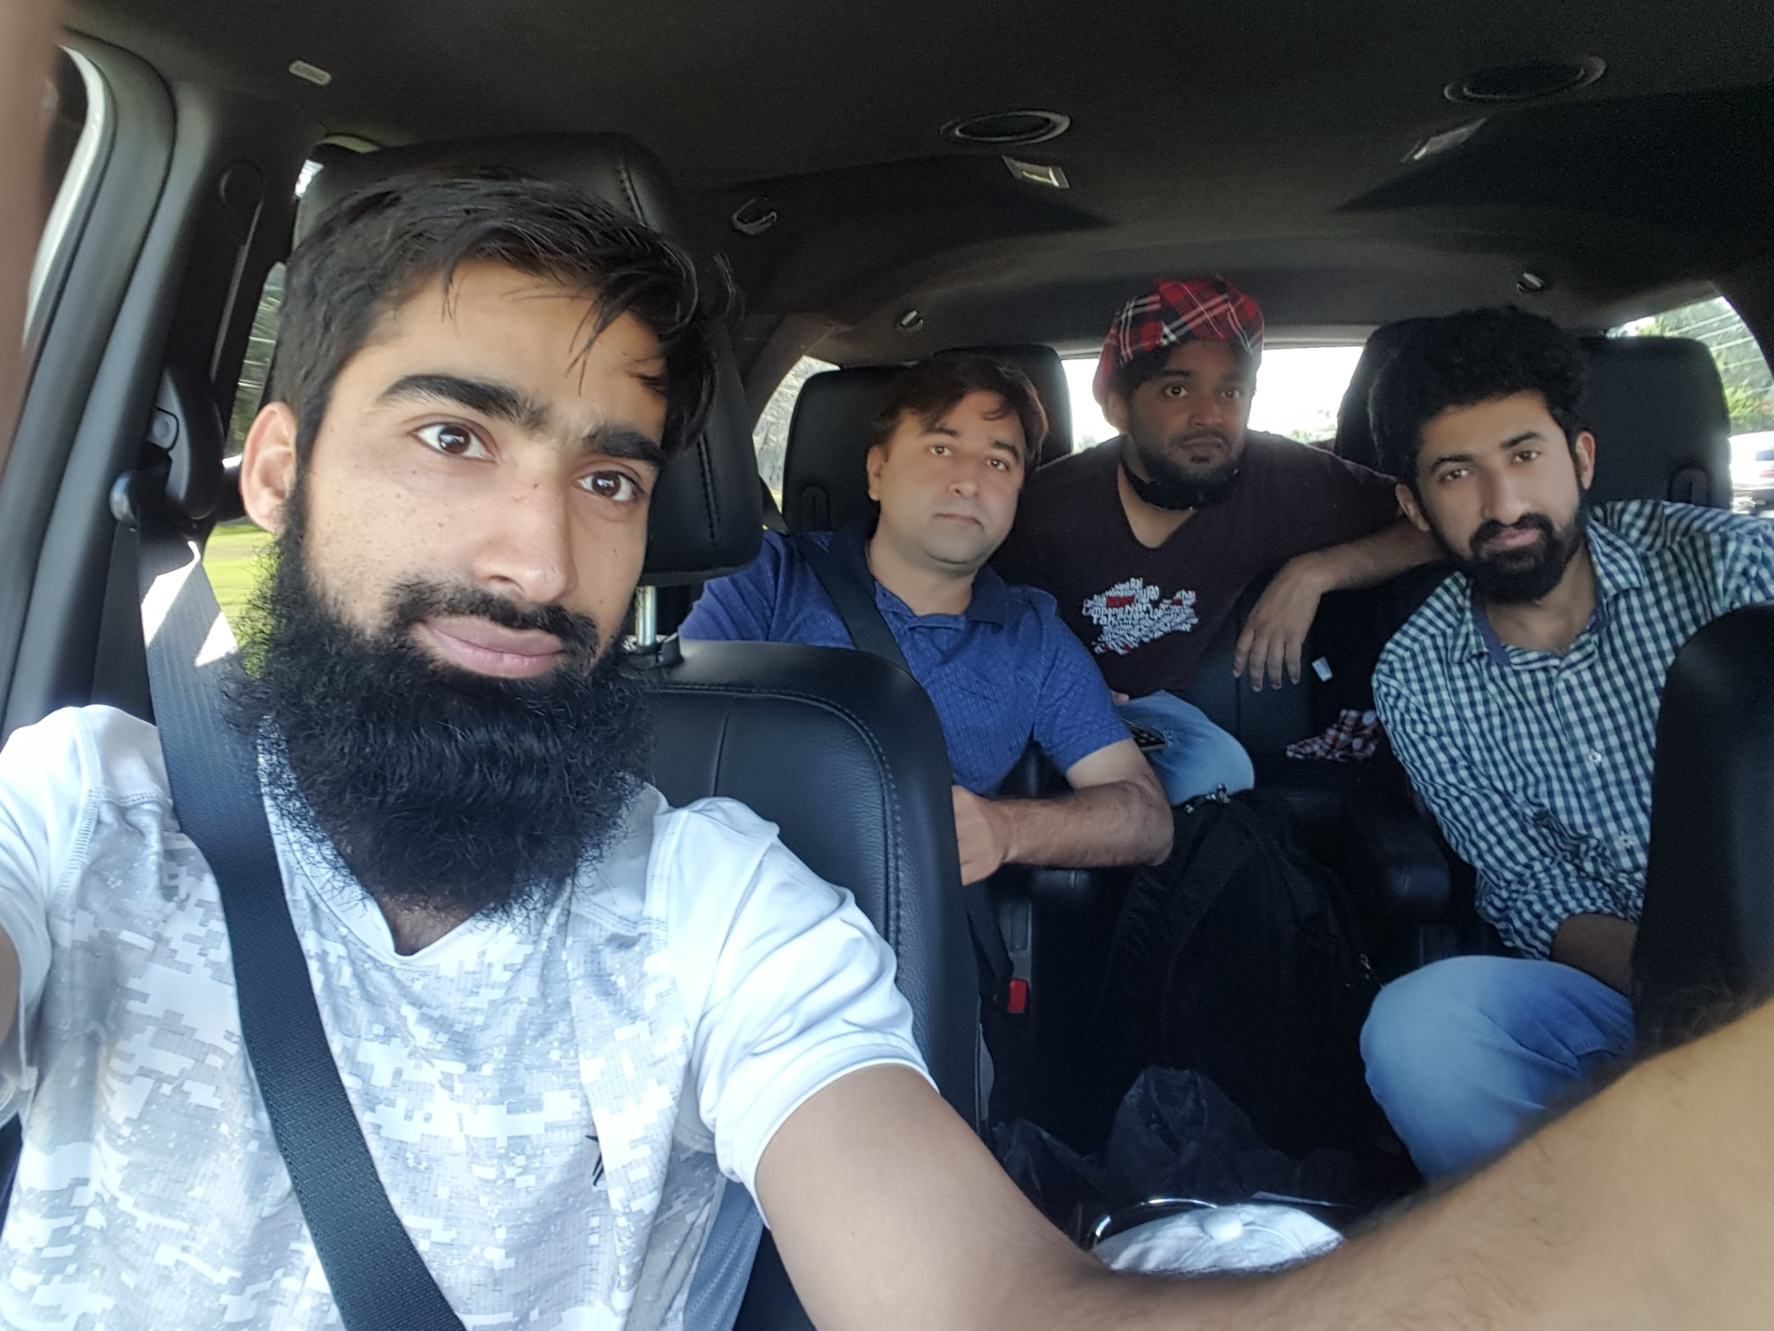
Dr. Sajid Iqbal
Department of Computer Science
Bahauddin Zakariya University, Multan

Slide 2
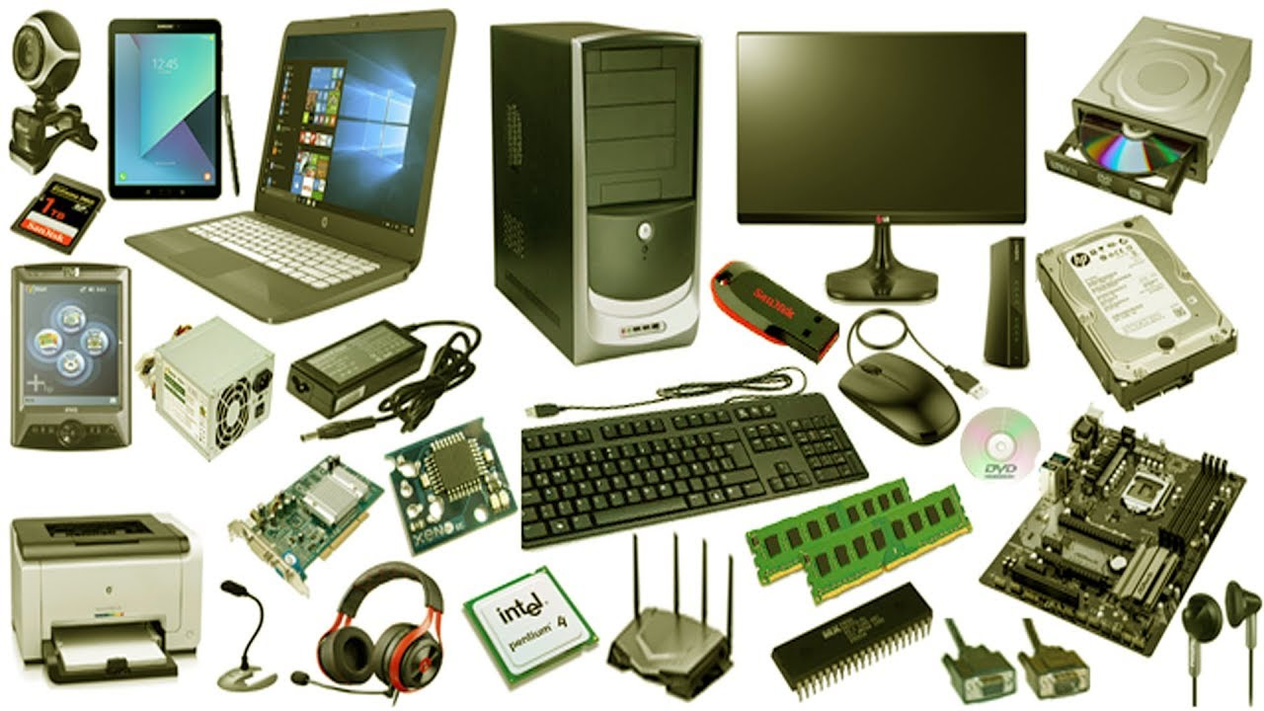
Computer Hardware
Introduction to computers

Slide 3
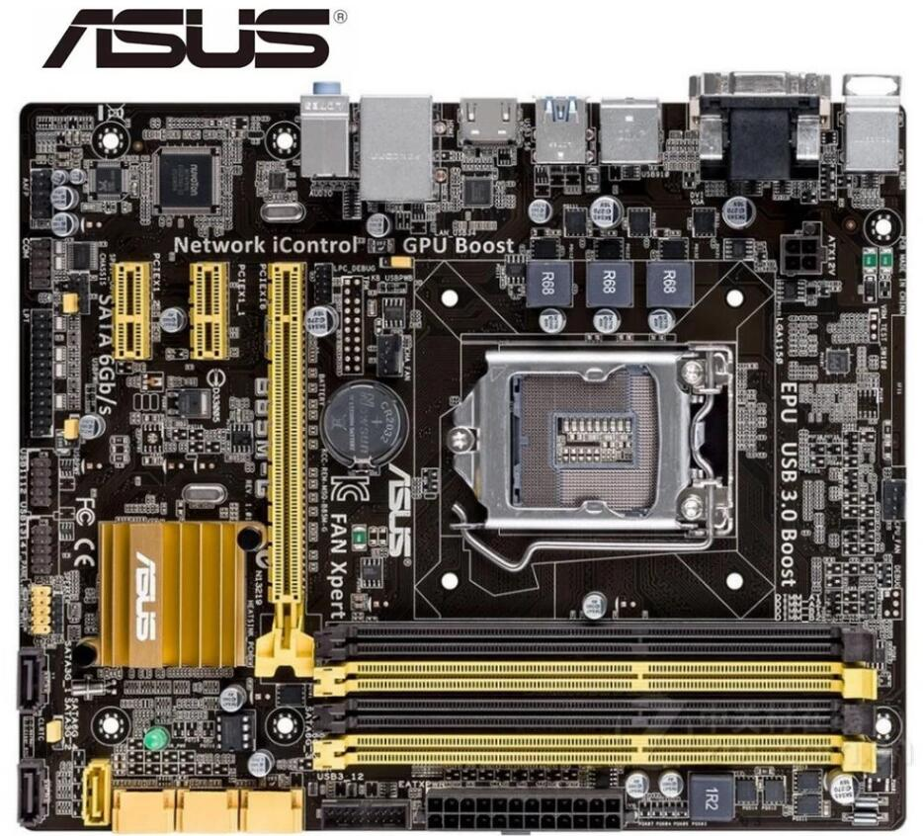
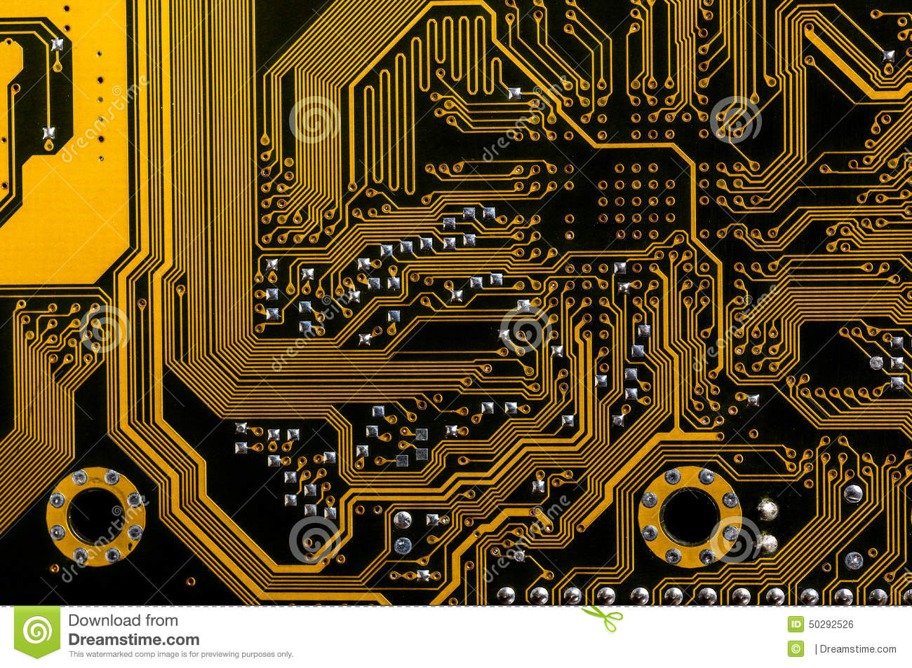
Motherboard
A mother board is printed circuit board
It allows other computer ICs to communicate
Mother boards are air cooled with heat sinks
It has many other sub-systems
Central processor
Input/output chipsets
Memory controllers
Interface connectors
A number of add-on cards can be installed
Memory cards
Processor
Video Cards
Sound Cards
Network Cards
Hard drives
USB Controllers
System Clock chip

Slide 4
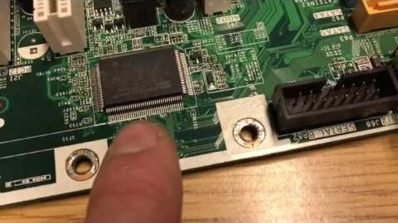
Motherboard
Thanks to YouTube video provider

Slide 5
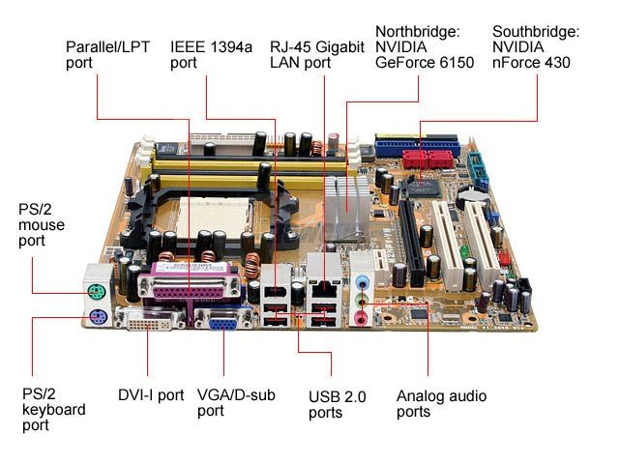
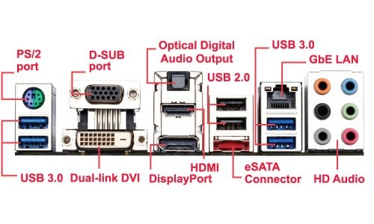
Ports
A port is an interface between motherboard and other devices
There are number of ports in mother board
Each port need specific connector

Slide 6
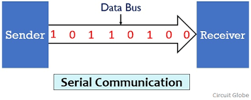
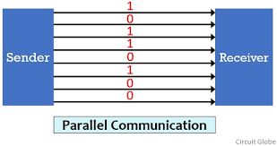
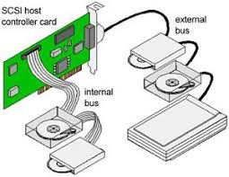
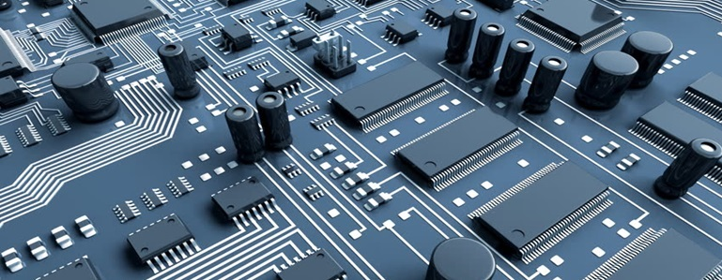
Buses (Electrical Buses)
A bus is a communication system that allows communication among different computer components
Early computer buses were parallel electrical wires with multiple hardware connections
Two ways of data transfer on buses
Parallel
Bit-serial
Buses could be either
Internal (local buses)
external

Slide 7
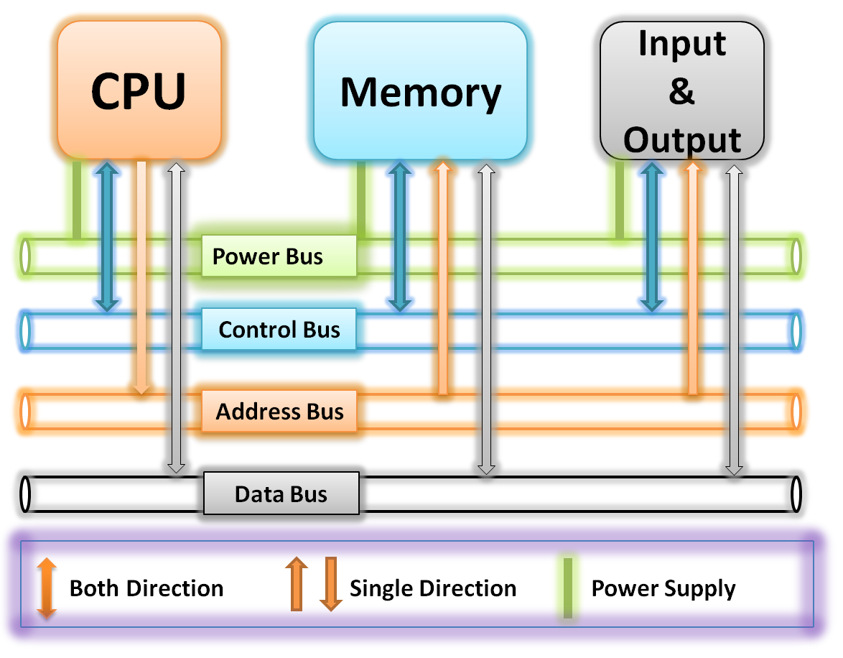
Electrical Buses
Bus Categories: There are three main bus categories
Data Bus: These buses actually transfer the data from one point to another
Address Bus: This bus specifies where data should be sent i.e. to which memory location of RAM
Control Bus: This type of bus controls the communication i.e. when to start sending data
Power bus: This bus supplies the current to all circuit. If no current is provided, the communication is not possible.
Bus width: The number of wires used in a bus i.e. 16, 24, 32

Slide 8
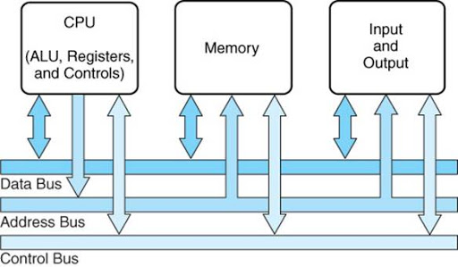
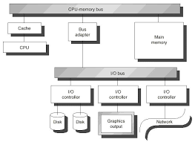
Bus Terminology
System Bus: The bus that connects the CPU to RAM on mother board
IO Buses: Connects various peripheral devices to CPU
Expansion buses:
ISA - Industry Standard Architecture
EISA - Extended Industry Standard Architecture
MCA - Micro Channel Architecture
VESA - Video Electronics Standards Association
PCI - Peripheral Component Interconnect
PCI Express (PCI-X)
PCMCIA - Personal Computer Memory Card Industry Association (Also called PC bus)
AGP - Accelerated Graphics Port
SCSI - Small Computer Systems Interface
Universal Serial Bus (USB)

Slide 9
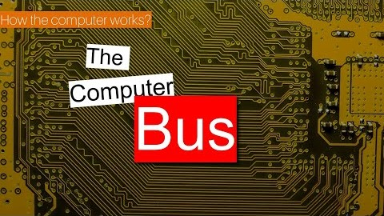
How Buses Work
Thanks to YouTube video provider

Slide 10
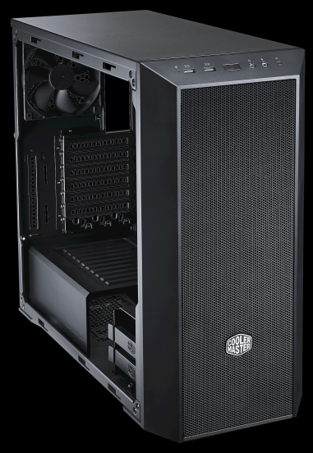
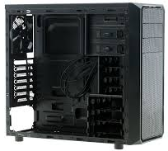
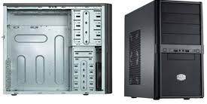
CPU Casing
There are variety of casing. You may choose one of your choice
CPU casing has space and configuration to install different computer components
Front end ports and back end ports

Slide 11
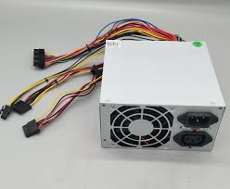
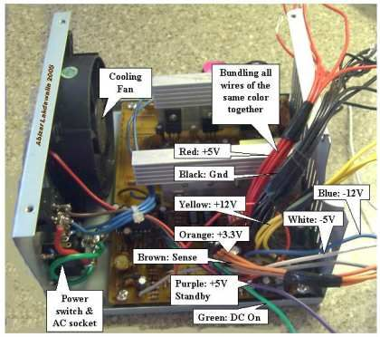
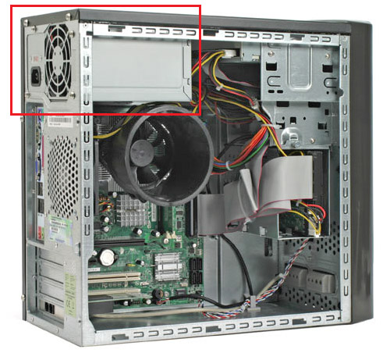
Main Power Supply
A power supply unit (PSU) converts mains AC to low-voltage regulated DC power for the internal components of a computer
Modern personal computers universally use switched-mode power supplies
Some power supplies have a manual switch for selecting input voltage, while others automatically adapt to the mains voltage

Slide 12



Thanks for watching
Dr. Sajid Iqbal
Assistant Professor
Department of Computer Science
Bahauddin Zakariya University, Multan
sajidiqbal.pk@gmail.com
https://github.com/sajjo79/Introduction-to-Computers
Allah Hafiz
COMEDXD

